Slide 1




International Covid 19 Chaplain study
6th/7th August 2020
Prof Austyn Snowden
Prof Anne Vandenhoeck
Dr Heather Tan

Slide 2
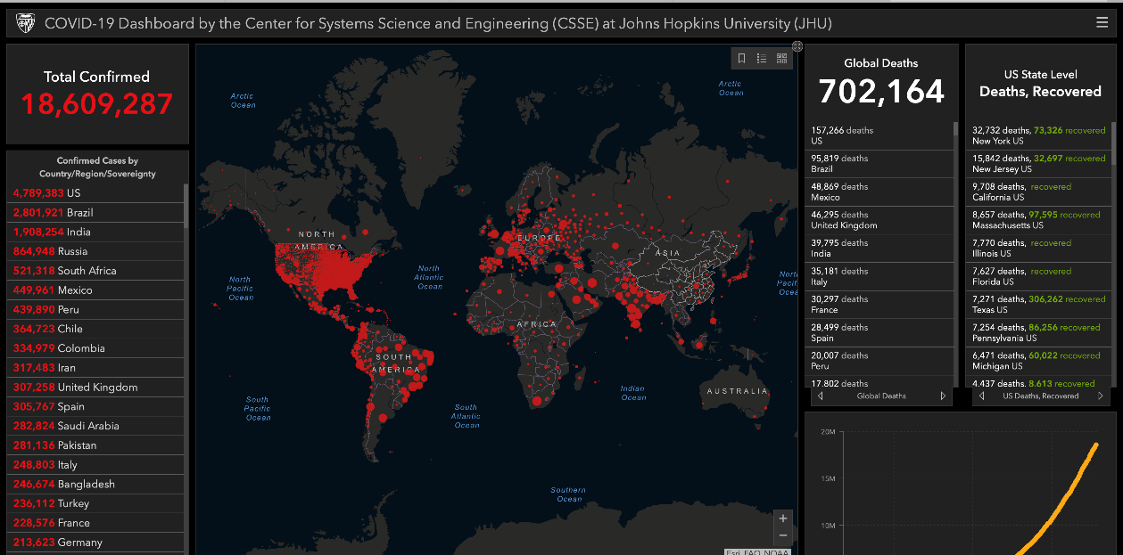
Overview

Slide 3
Aim
To understand how chaplains delivered spiritual care during Covid-19 global pandemic.
Objectives:
  Describe how healthcare chaplains delivered spiritual care during the pandemic.
  Identify the key changes to usual practice and examine their impact on chaplains, patients, staff and culture.

Slide 4
Objective | Survey question
Describe how healthcare chaplains delivered spiritual care during the pandemic. | Continent, country, age, gender, faith, years as chaplain, qualification, professional association (table 2)
 | Which setting do you usually work in?
 | Which setting did you work in during the pandemic?
 | When were you asked to provide spiritual care?
 | Did you have access to COVID-19 patients?
 | Did you have access to NON COVID-19 patients?
 | How clear was your role to you?
 | Do you have regular supervision, intervision, or other form of regular group reflection?
 | Did you feel that you could have been better deployed during the pandemic?
Identify the key changes to usual practice and examine their impact on chaplains, patients, staff and culture. | How anxious/afraid were you?
 | Did your organisation limit your access to COVID-19 patients?
 | How have you taken care of yourself since the beginning of the pandemic?
 | What did you need that was NOT available?
 | Did your organisation understand the contribution you could offer to COVID-19 patients?
 | Which issues had the greatest impact on you during the pandemic? (list)
 | Did staff other than the chaplain deliver spiritual care?
 | Was your professional association supportive?
 | Was your faith/belief group supportive?
 | How do you think this pandemic has changed our profession?

Slide 5

Objective | This presentation
Describe how healthcare chaplains delivered spiritual care during the pandemic. | Demographics Did your work setting change during the pandemic? Did you have access to Covid Patients and non covid patients How clear was your role to you? (By months: Jan, Feb…May) Did you have regular supervision/intervision? Do you feel you could have been better deployed? What had the greatest impact on you? (list) How has the pandemic changed healthcare chaplaincy?
Identify the key changes to usual practice and examine their impact on chaplains, patients, staff and culture.

Slide 6

Survey disseminated worldwide
From APC, ERICH, Australia…

Slide 7
Notes:
Australia
202
Austria
9
Belgium
131
Canada
40
Chile
2
Colombia
3
Cyprus
2
Czech Republic
9
Denmark
1
Estonia
5
Finland
13
France
9
Germany
89
Hong Kong
1
Hungary
4
India
3
Indonesia
1
Ireland
22
Israel
4
Italy
5
Kenya
1
Latvia
1
Luxembourg
9
Malta
1
Netherlands
173
Norway
16
Philippi
4
Portugal
2
Romania
1
Spain
4
Sweden
15
Switzerland
31
UK
109
Ukraine
1
USA
688

Slide 8
Results
N=1657
Europe N=666
N America & Canada N=730
Australia N=202
Asia N=12
Africa/ S America N=8
Total completed surveys
Continents
Average time to complete survey around 13 minutes

Slide 9
Mean age and mean number of yrs in service
Australia (N=200)
Mean Age 58
Mean time = 9 years
Europe (N=660)
Mean Age 53
Mean time = 14 years
N Am (N=690)
Mean Age 58
Mean time = 12 years

Slide 11
Education level by Continent

Slide 12
Religion by Continent

Slide 13
Summary Demographics
Continent | Age (SD) yrs | Years (SD) as chaplain | Gender (n) |  | Main religion or faith (n=) |  | Highest qualification (n=) |  | Team or alone (n=) |  | Professional association (n=)
North America | 58 (13.1) | 14 (10.9) | Male | 308 | Protestant | 481 | PhD | 147 | Team | 590 | Yes | 562
 |  |  | Female | 391 | Catholic | 105 | Masters | 528 | Alone | 84 | No | 114
 |  |  |  |  | Jew | 56 | Bachelor | 27
 |  |  |  |  | Humanist | <10 | High Sch | <10
 |  |  |  |  | Buddhist | <10
Europe | 52.5 (10.8) | 14 (9.7) | Male | 259 | Protestant | 325 | PhD | 66 | Team | 466 | Yes | 499
 |  |  | Female | 391 | Catholic | 234 | Masters | 422 | Alone | 137 | No | 113
 |  |  |  |  | Jew | <10 | Bachelor | 119
 |  |  |  |  | Humanist | 40 | High Sch | 12
 |  |  |  |  | Buddhist | <10
Australia | 57.8 (9.1) | 9.5 (7.7) | Male | 70 | Protestant | 105 | PhD | 11 | Team | 148 | Yes | 96
 |  |  | Female | 124 | Catholic | 63 | Masters | 70 | Alone | 39 | No | 92
 |  |  |  |  | Jew | <10 | Bachelor | 87
 |  |  |  |  | Humanist | <10 | High Sch | <10
 |  |  |  |  | Buddhist | <10

Slide 14
Reminder
Did your work setting change during the pandemic?
Did you have access to Covid Patients and non covid patients
How clear was your role to you? (By months: Jan, Feb..May)
Did you have regular supervision/intervision?
Do you feel you could have been better deployed?
What had the greatest impact on you? (list)
How has the pandemic changed healthcare chaplaincy?

Slide 15
Work setting changed?
Notes:
The ‘other’ category both before and after consisted of: parish, military, community, prison, private practice, law enforcement, palliative care, school, university, research, rehabilitation, outreach, learning difficulties, oncology, management, home care, primary care (general practice), continuing care, church, ambulance and administration.
Of those that commented on the change, ten described working remotely or from home, eight described themselves as shielding due to their own health issues, four mentioned that they were no longer permitted to visit the hospitals they worked in, and one took early retirement.

Slide 16
Did you have access to patients during the pandemic? Both Covid & non-covid patients
Allowed in room
20% non covid
8% Covid
Only access to family members
20% non covid
6% Covid
Through technology
20% non covid
60% Covid

Slide 17
How Clear was your role to you?
0= Completely Unclear
1= Unclear
2= Neutral
3= Clear
4= Completely Clear

Slide 18
Did you have regular Supervision, Intervision or other group Reflection?

Slide 19
Do you feel you could have been better deployed?
 | Yes | No
Australia | 118 | 23
Europe | 288 | 129
North America | 362 | 109
Australia
Europe
N America

Slide 20

Some explanation…
Chaplain leadership should have been at the executive leadership table during discussions of how to manage the pandemic, how to address patient isolation, family anxiety as a result of absence from their hospitalized loved ones.
Although we say that chaplains are integral team members, chaplains were not part of the discussions about both COVID and non-COVID patient care management at the outset. This should have happened.
Chaplains should have been involved in more and direct patient care throughout the pandemic. *The attitude of leadership and nursing seemed to be that EVERYONE besides doctors and nurses would spread COVID, so everyone besides doctors and nurses must be excluded from encountering COVID patients.

Slide 21
What bothered you the most?
Notes:
In summary, social distancing had the greatest impact on chaplains around the world, followed by concerns for the dignity of patients. Whilst all were clearly concerned about practical issues such as shortages of materials, it was those aspects impacting on their ability to help others that had the greatest impact.

Slide 22
Free text analysis

Slide 23




44000 words
Imported into NVivo
1192 respondents
10% non-English
Coded line by line

Slide 24
What’s changed? Grounded Theory
Being challenged to the core
Excluded
Separated
Redundant
Being present
Ready next time
Being innovative
Being where we are needed
Being SEEN

Slide 25
Next steps

Slide 26
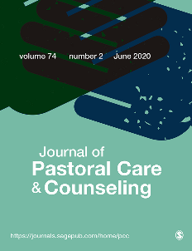
Joost
Heather
Anne
Austyn
Cheryl
Trace
Cate
Wendy

