Slide 1
The Wound or the Bandage?
Looking into the face of Spiritual Distress
James Woodward AHPCC 21st May 2024

Slide 2
Overview and core questions
1.How do we handle spiritual distress ?
2. Listening to Dennis Potter
3. What does spiritual distress look like ?
4. What gets lost in the defining (stairs and landing) ?
5. What works for us ?
6. Our mortal Woundedness?
7. Responses and Questions

Slide 3
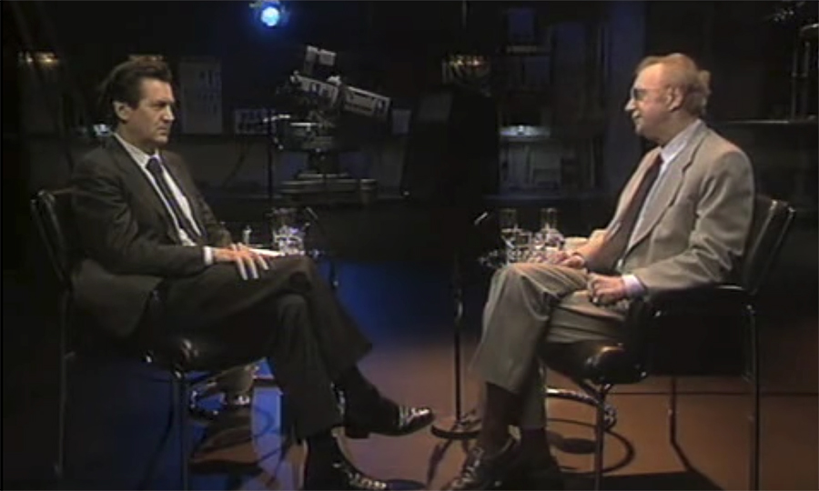
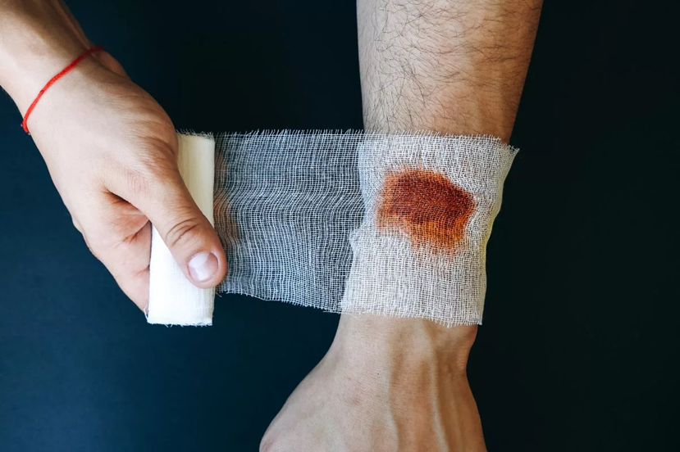
Dennis Potter Seeing the Blossum
https://www.youtube.com/watch?app=desktop&v=3xQiOle0o8k

Slide 4


Slide 5
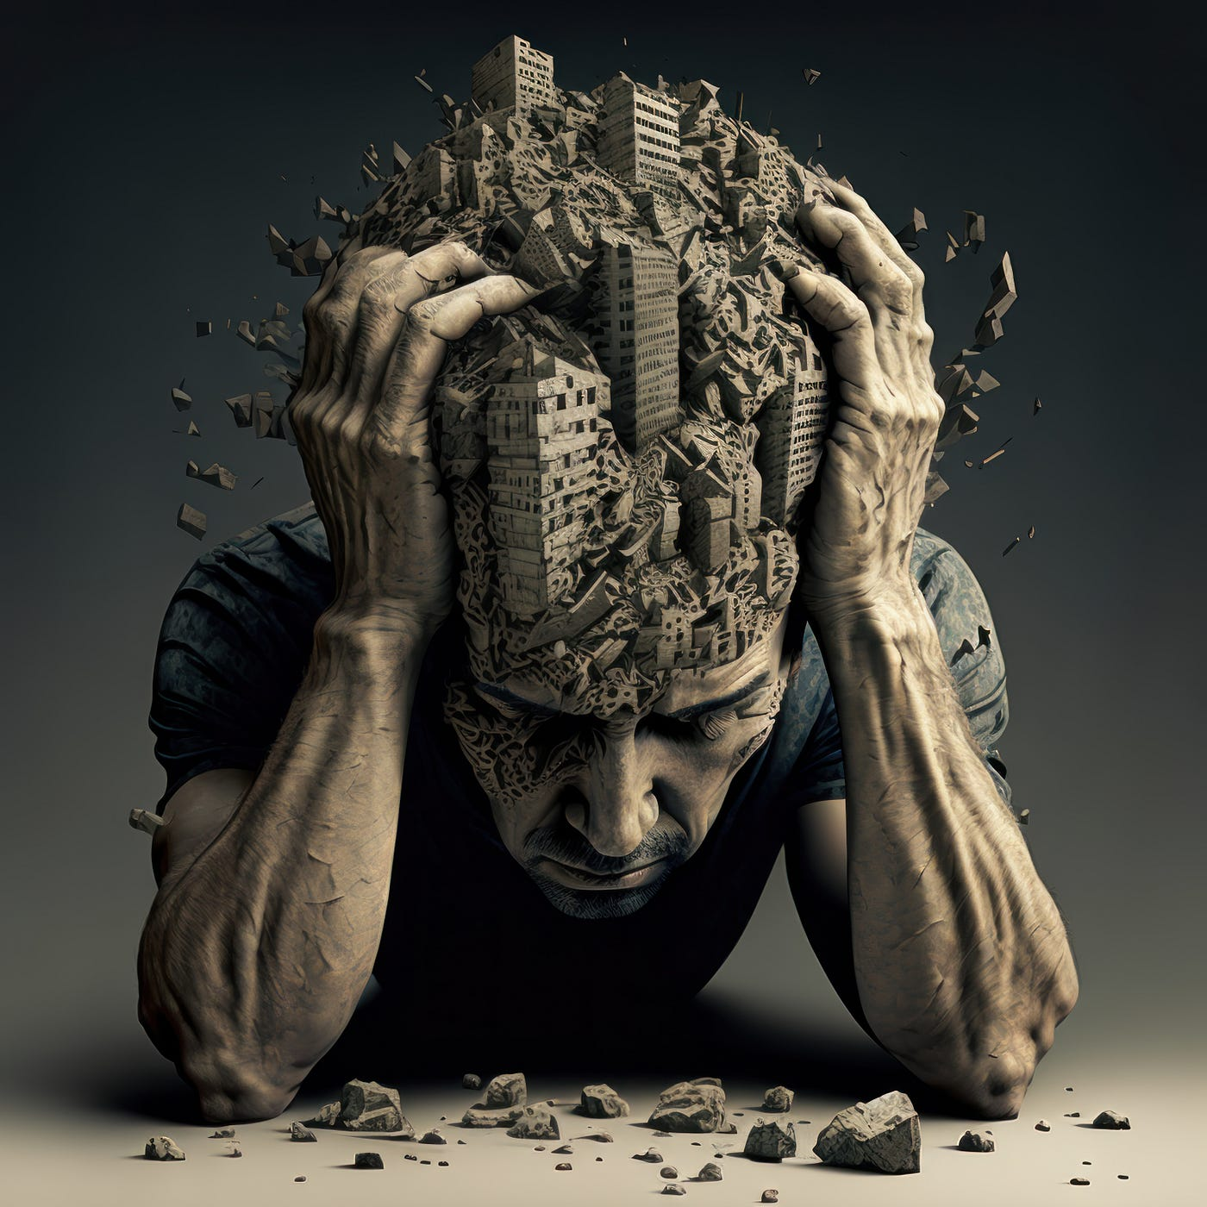
What does distress look and feel like ?

Slide 6
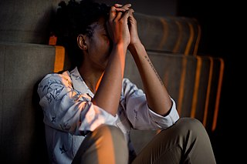
What does distress look and feel like ?

Slide 7
The answer to the question
Yes, I’m all right. I like it on my own,
but tears come unannounced. Outside
and inside hurt. Moments and memories
stab. My skin is thin and everything
now pierces to the bone.
I’m happy with my friends but glad to be alone,
and now the future opens up so wide
with questions, gaps and possibilities
for when returning strength and optimism bring
what cannot yet be known.
Eleanor Nesbitt April 2024

Slide 8
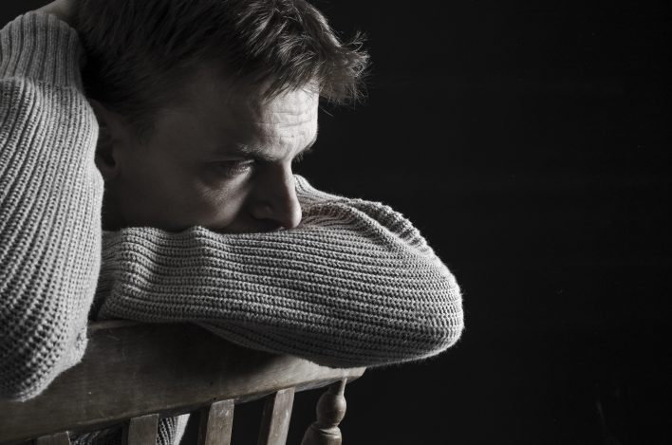
What does distress look and feel like ?

Slide 9
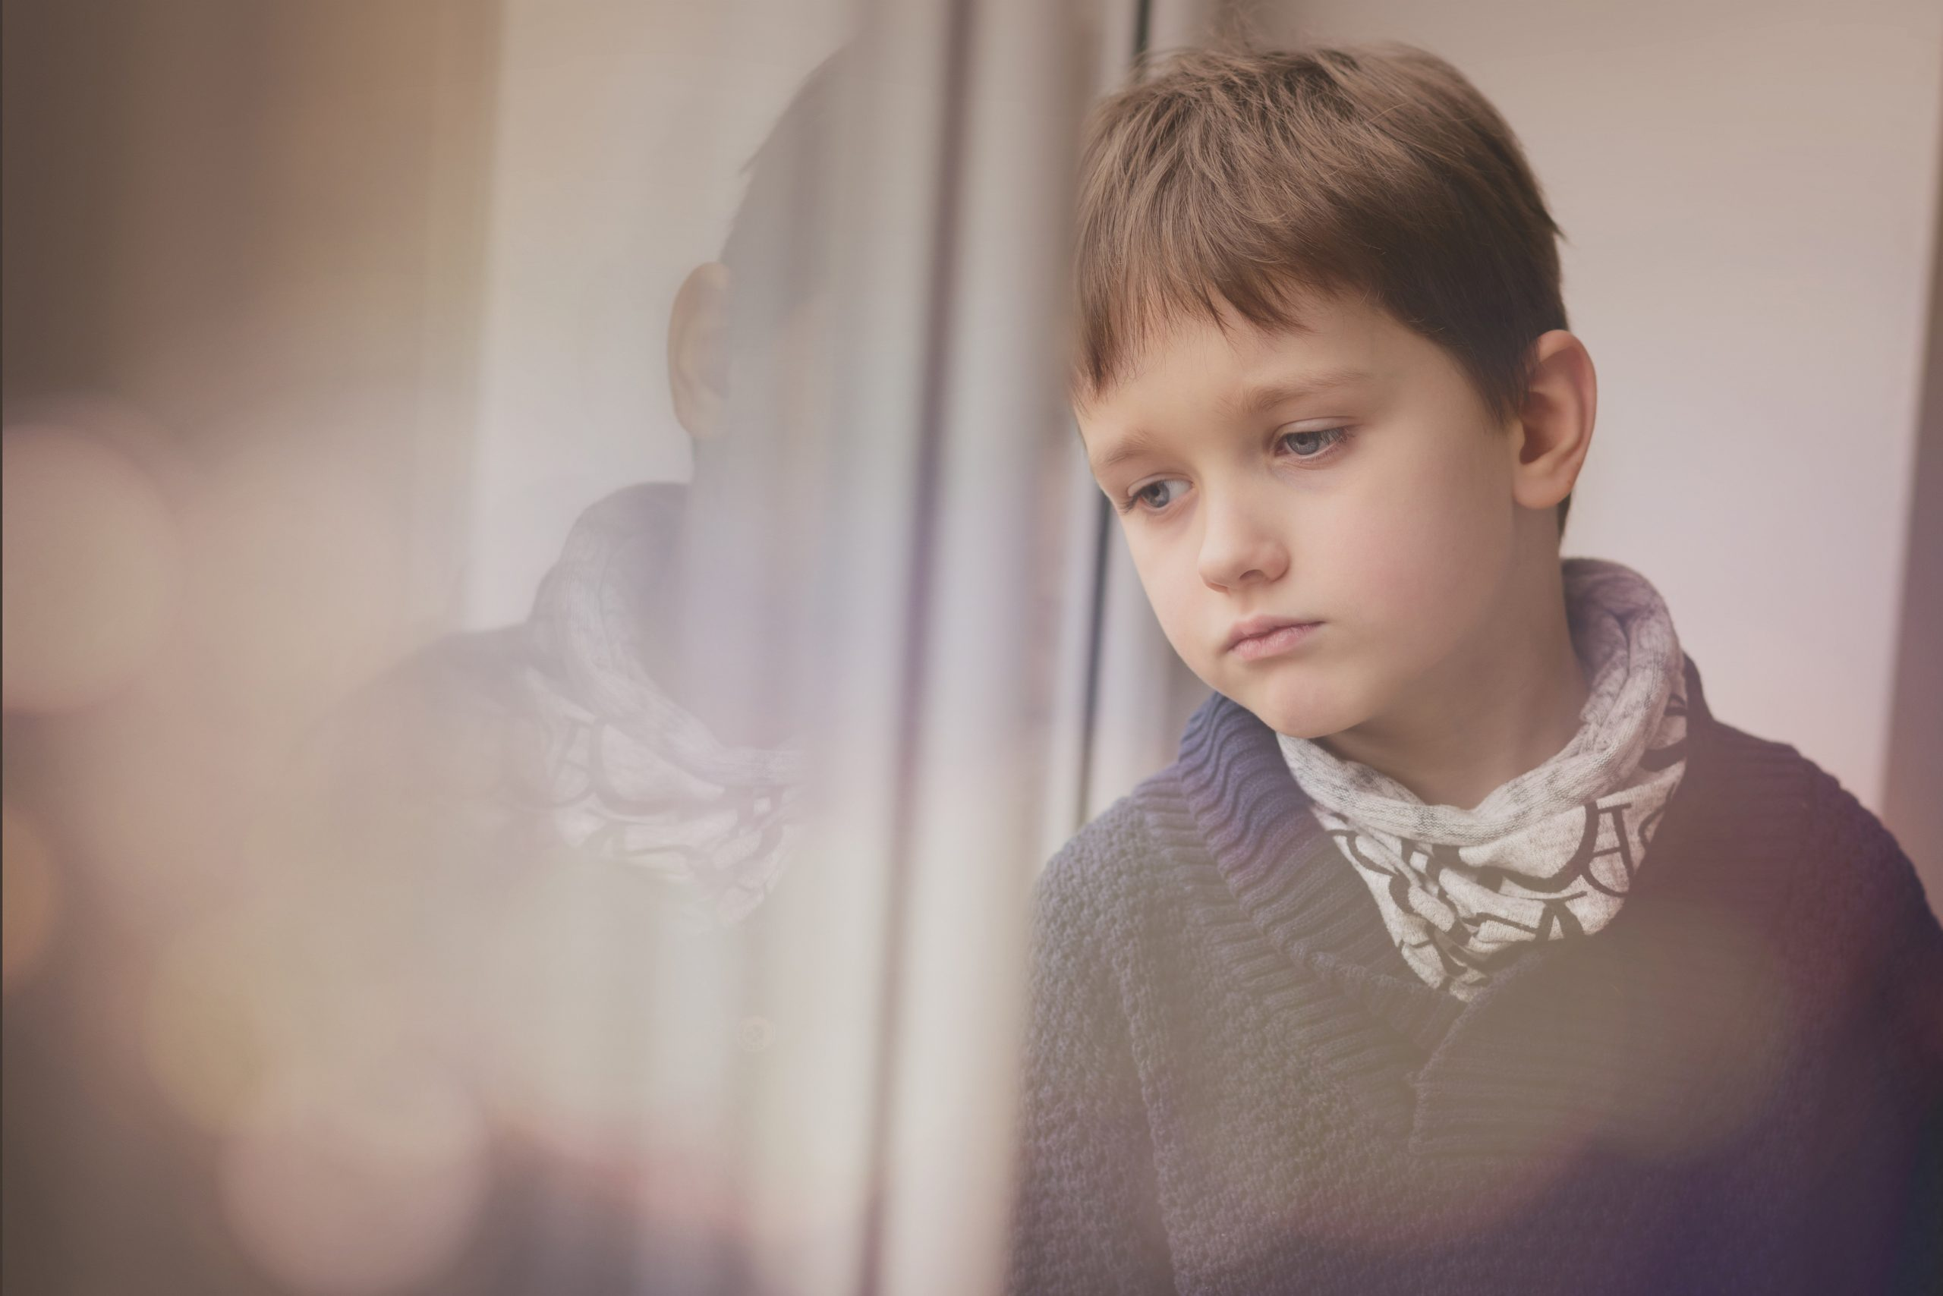
What does distress look and feel like ?

Slide 10
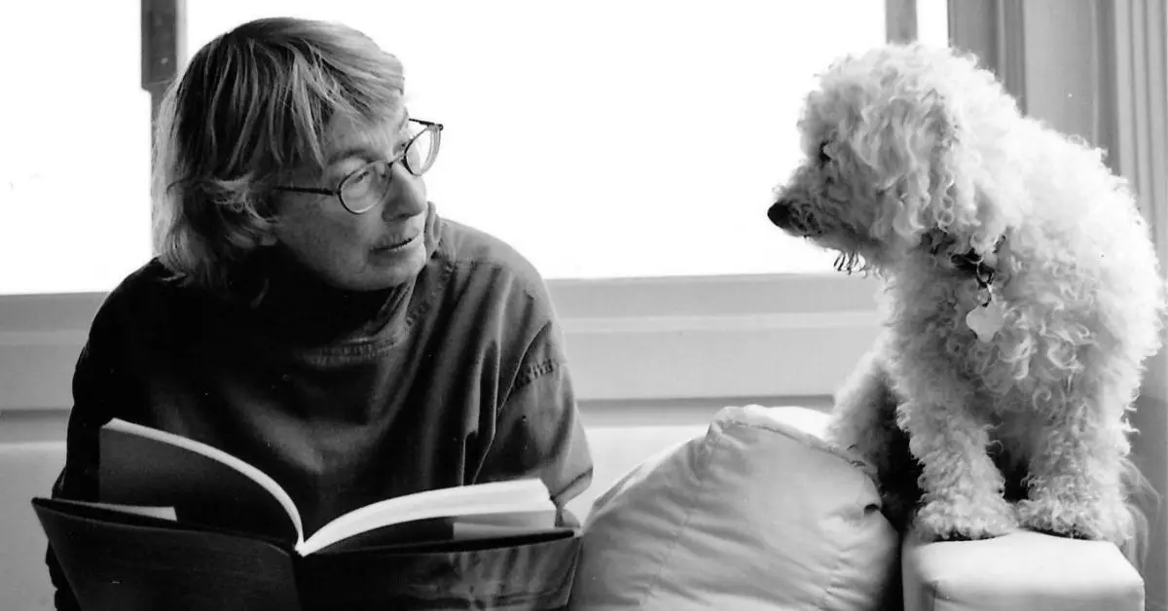
Love Sorrow Mary Oliver

Slide 11
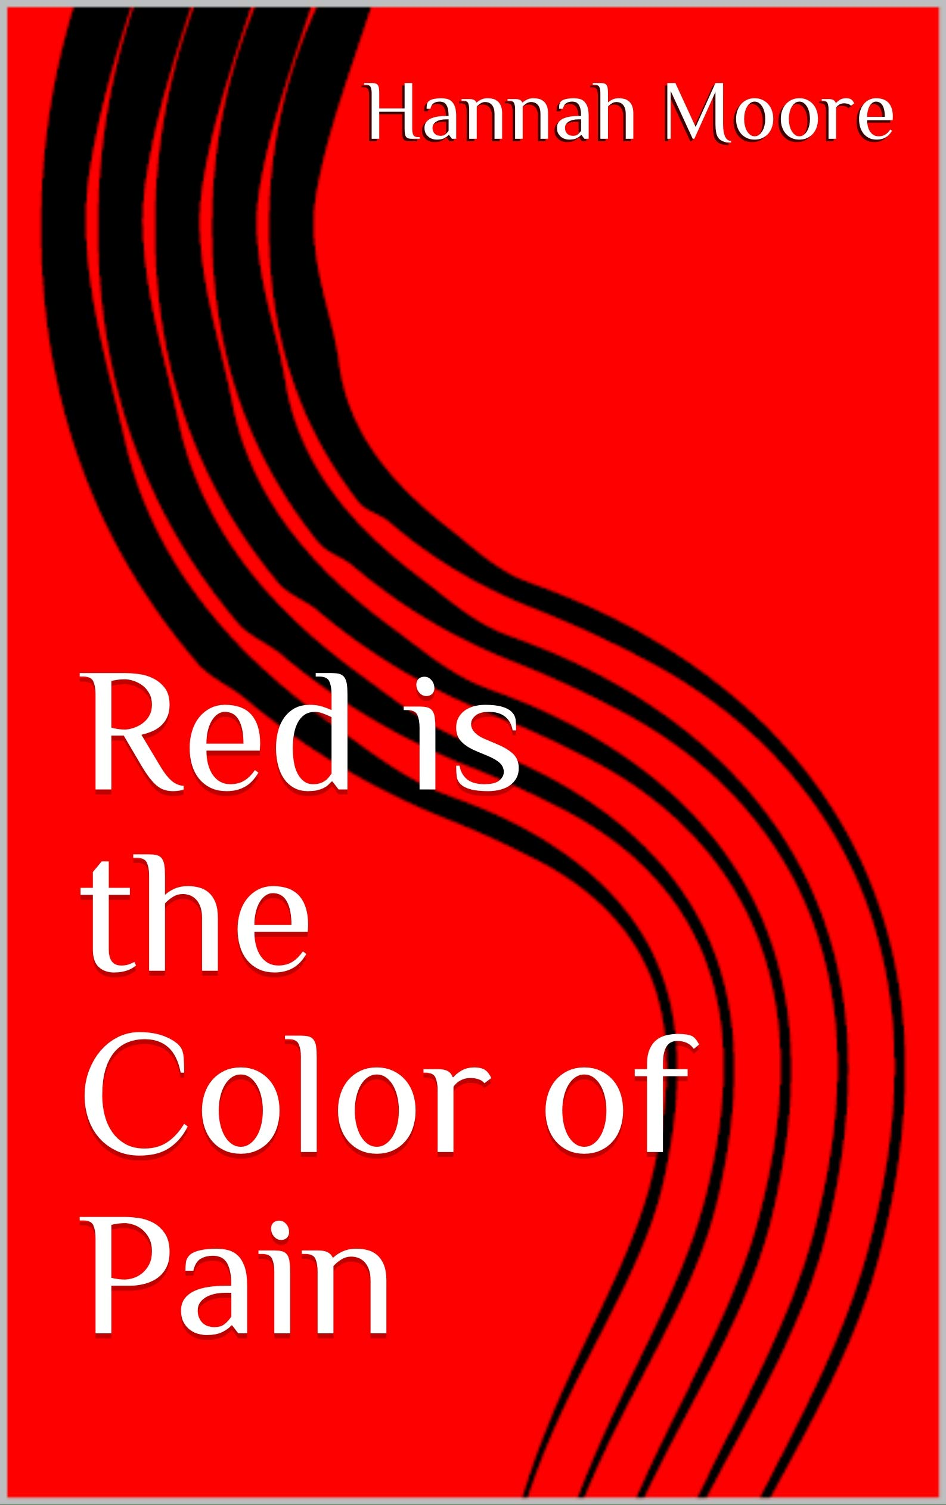

The shape and colour of Pain

Slide 12

Putting Spiritual Pain into a broader framework

Slide 13
What shapes a definition ?
Modern usages tend to refer to
a subjective experience of a sacred dimension
the "deepest values and meanings by which people live” often in a context separate from organized religious institutions.
This may involve belief in a supernatural realm beyond the ordinarily observable world, personal growth, a quest for an ultimate or sacred meaning, religious experience, or an encounter with one's own "inner dimension".

Slide 14
Do these four categories ‘work’ for us?
1. Meaning – struggling with the “meaning” behind life, relationships, and the world around you
2. Forgiveness – pain that stems from forgiving others, ourselves and God
3. Relatedness – dealing with relationships, whether good or bad
4. Hope – feeling like there is no hope or it doesn’t exist

Slide 15
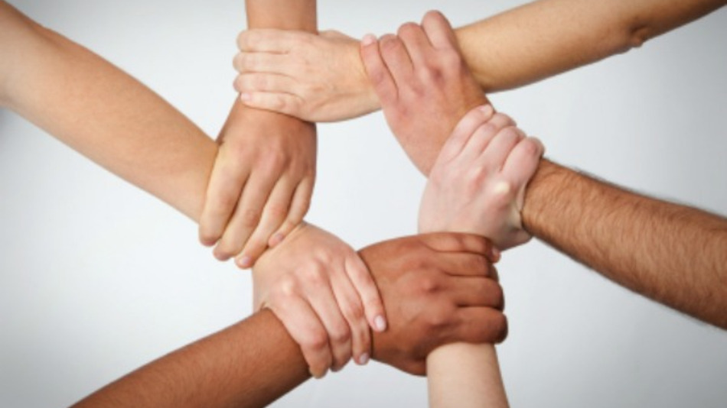

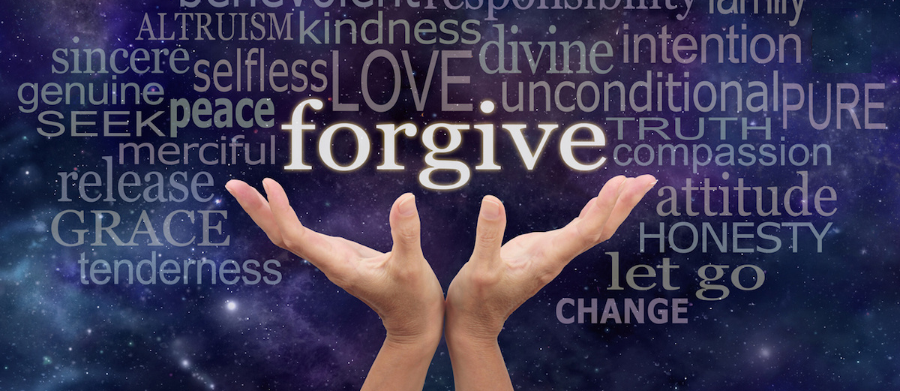
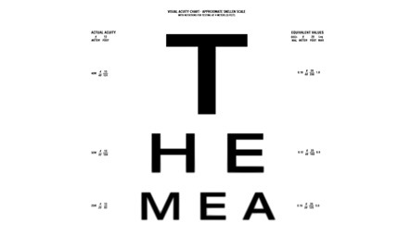

Slide 16
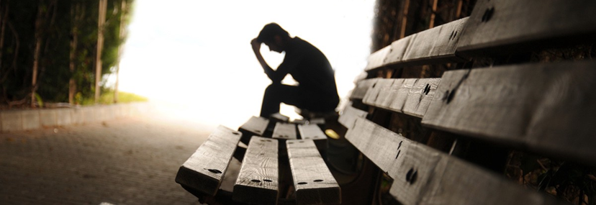
What is spiritual distress or pain?

Slide 17
Spiritual pain is the pain that comes from the “hidden” areas of our life. It can’t be pointed to on a pain scale, but it is still very real and can impact our physical and emotional health.
These emotions can include painful memories, regret, guilt, anger and fear. However, spiritual pain does not simply arise from fears about the future. As Saunders and Sykes (1993) point out: ‘There may be bitter and most understandable anger at the unfairness of what is happening … and above all a desolating feeling of meaninglessness.’
We often shy away from dealing with a patient who is in spiritual pain, even though we acknowledge that attending to their spiritual needs is part of holistic nursing care. This distancing may be because many of us have not faced up to our own woundedness or pain or mortality

Slide 18
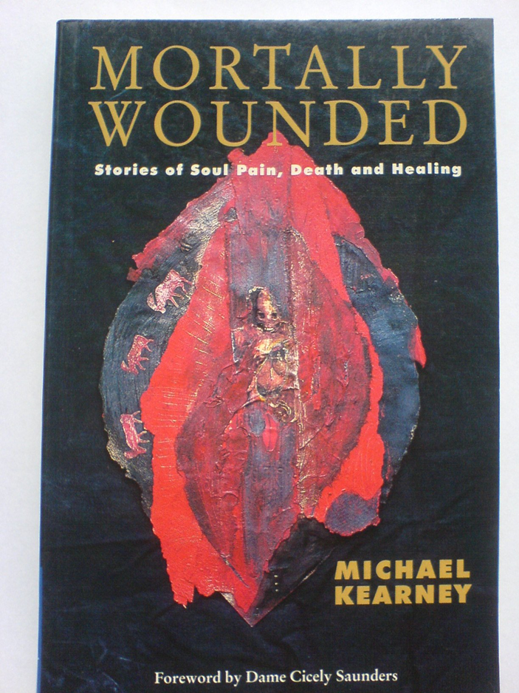
Pain insists on being attended to. God whispers to us in our pleasures, speaks in our conscience but shouts to us in our pain. It is his megaphone to rouse a deaf world. CS Lewis The problem of Pain
At the end of one spectrum are experiences such as connection, alignment, harmony and meaningfulness which might be summarized as being healed, at the other extreme are the experiences of disconnection, disharmony, non- alignment and disintegration which constitute spiritual pain. Kearney

Slide 19
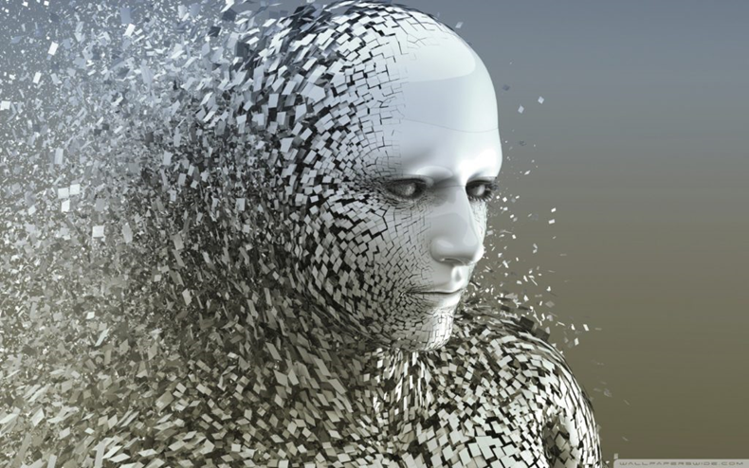

Slide 20
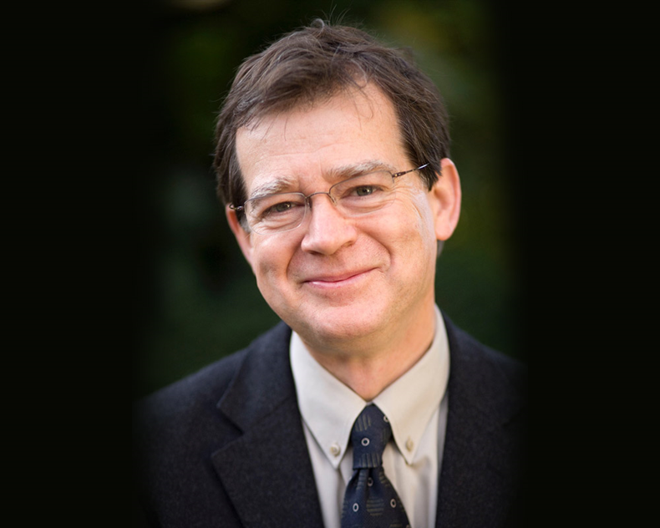
Being Alongside
In the end what qualifies me to be alongside another person in spiritual pain is not my training but my own commitment to my own inner journey – the fact that I am crossing thresholds in my own experience, the fact that I am prepared, however falteringly, to entrust to the wisdom of my own deep unknowing. It is this belief that this area is not so much about skills I have but the self that I am.

Slide 21
Doing Theology / Being Reflective ?
God is abundant and so is the life that God wants for us?
How do create, sustain and celebrate abundant life?
Naming our experience of grace and kindness.
Where is your experience of comfort and restoration?
How do we bring/ share/ see Hope ?
Ingenuity, resilience, honesty, creativity, inclusion.

Slide 22
Thank you
James Woodward
www.sarum.ac.uk
jww@sarum.ac.uk
www.jameswoodward.online

